Slide 1

Manually remove
Excel Add-in
AVer Information Inc.

Slide 2
Manually Remove Excel Add-in
Please use the following steps to remove Excel Add-in manually.
  Launch Excel -> Go to Tools -> Press Excel Add-ins…
  Uncheck Aplusexceladdin and press OK.
  Close Excel Add-in dialog.

Slide 3
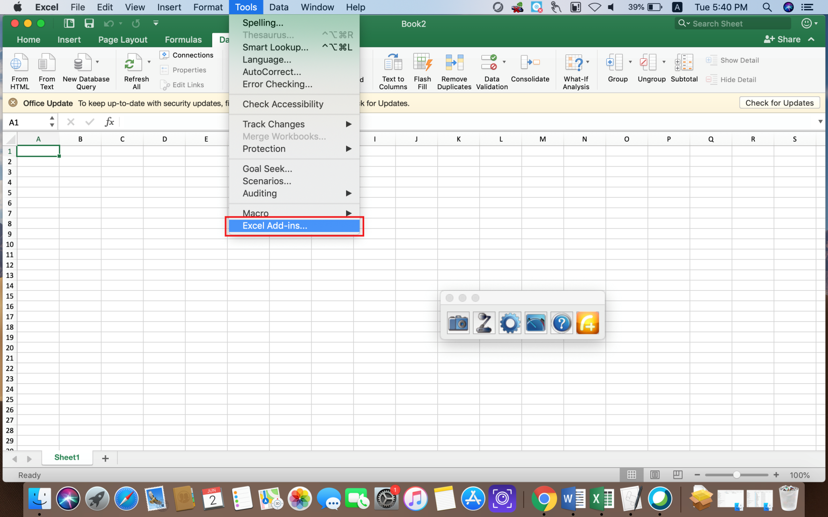
Manually Remove Excel Add-in
Launch Excel -> Go to Tools -> Press Excel Add-ins…

Slide 4
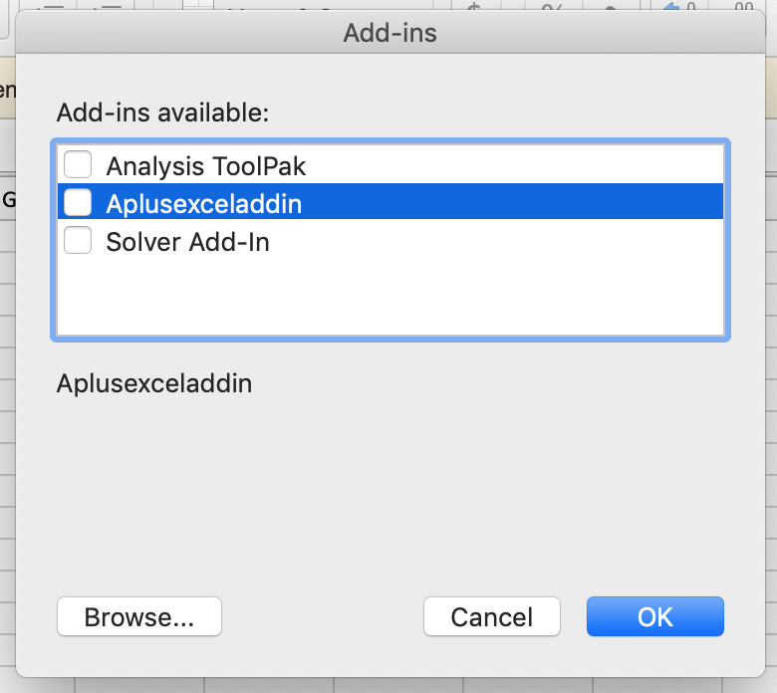
Manually Remove Excel Add-in
Uncheck Aplusexceladdin and press OK.

Slide 5

Manually Remove Excel Add-in
Close Excel Add-in dialog.

